Slide 1

Project Title -Seasonal Agriculture Performance Analysis
Student Name-Ravi Kumar
AICTE STU ID : STU6a6438c1bf14a1784953025
College Name- Quantum University Roorkee, Uttarakhand

Slide 2

PROBLEM STATEMENT
Agricultural performance can change from season to season due to weather, farming practices, available resources, and market conditions.
The raw agricultural data does not clearly show how performance changes across different seasons.
It is difficult to identify important patterns, trends, and relationships just by looking at the raw data.
Therefore, this project aims to analyze the agricultural dataset and find meaningful seasonal patterns and variations.

Slide 3
Project Description
This project is about analyzing agriculture data from different seasons.
It helps us understand crop production and crop performance.
The data is cleaned and analyzed using Python.
Different graphs and charts are used to understand the data easily.
The main aim is to find useful information and trends from the agriculture data.
This analysis can help in better planning and decision-making in agriculture.

Slide 4

WHO ARE THE END USERS?
Farmers – To understand crop performance and production trends.
Agricultural Organizations – To monitor and analyze agricultural performance.
Agricultural Officers – To make better decisions based on crop and farming data.
Data Analysts & Researchers – To identify patterns, trends, and useful insights from agricultural data.
Government & Policy Makers – To support better agricultural planning and policy decisions

Slide 5

Technology Used
Python – Data analysis and processing
Pandas – Data cleaning and manipulation
NumPy – Numerical computations
Matplotlib – Data visualization
Seaborn – Statistical data visualization
Google Colab – Development and execution environment
CSV Dataset – Source of agricultural performance data

Slide 6
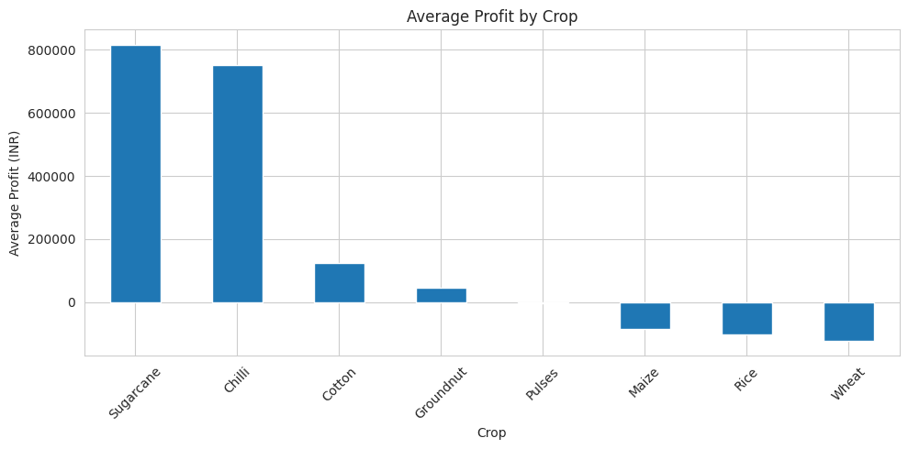
RESULTS:Average Profit by Crop
CODE:-
profit_crop = df.groupby("Crop")["Profit_INR"].mean().sort_values(ascending=False)
plt.figure(figsize=(10,5))
profit_crop.plot(kind="bar")
plt.title("Average Profit by Crop")
plt.xlabel("Crop")
plt.ylabel("Average Profit (INR)")
plt.xticks(rotation=45)
plt.tight_layout()
plt.show()
Observation:-
From the chart, Sugarcane and Chilli have the highest average profit. Some crops have negative average profit.
So, profit is quite different from one crop to another

Slide 7
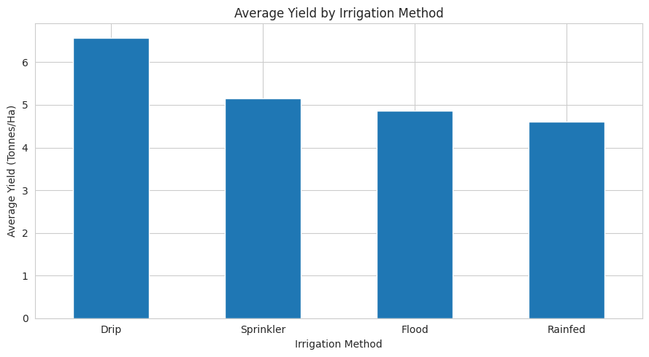
RESULTS: Average Yield by Irrigation Method
CODE:-
yield_irrigation = df.groupby("Irrigation_Method")["Yield_Tonnes_Ha"].mean().sort_values(ascending=False)
plt.figure(figsize=(9,5))
yield_irrigation.plot(kind="bar")
plt.title("Average Yield by Irrigation Method")
plt.xlabel("Irrigation Method")
plt.ylabel("Average Yield (Tonnes/Ha)")
plt.xticks(rotation=0)
plt.tight_layout()
plt.show()
Observation:-
Drip irrigation has the highest average yield in this dataset. Rainfed farms have the lowest average yield among the four methods.
This is an observation from the dataset and does not prove that irrigation method alone causes the difference.

Slide 8
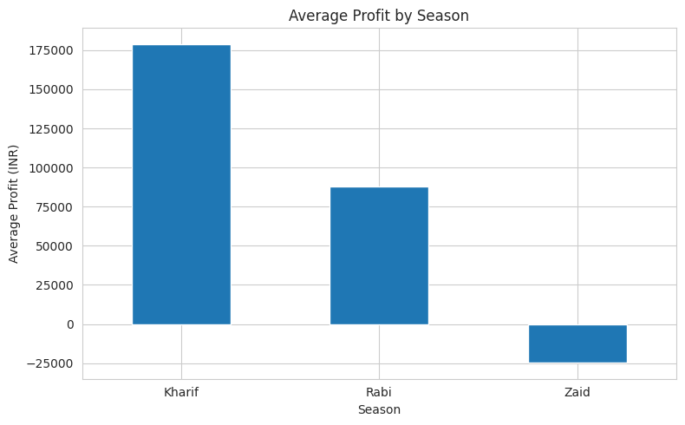
RESULTS: Average Profit By Season
CODE:-
profit_season = df.groupby("Season")["Profit_INR"].mean().sort_values(ascending=False)
plt.figure(figsize=(8,5))
profit_season.plot(kind="bar")
plt.title("Average Profit by Season")
plt.xlabel("Season")
plt.ylabel("Average Profit (INR)")
plt.xticks(rotation=0)
plt.tight_layout()
plt.show()
Observation:-
Kharif has the highest average profit. Rabi is lower, while Zaid has negative average profit in this dataset

Slide 9
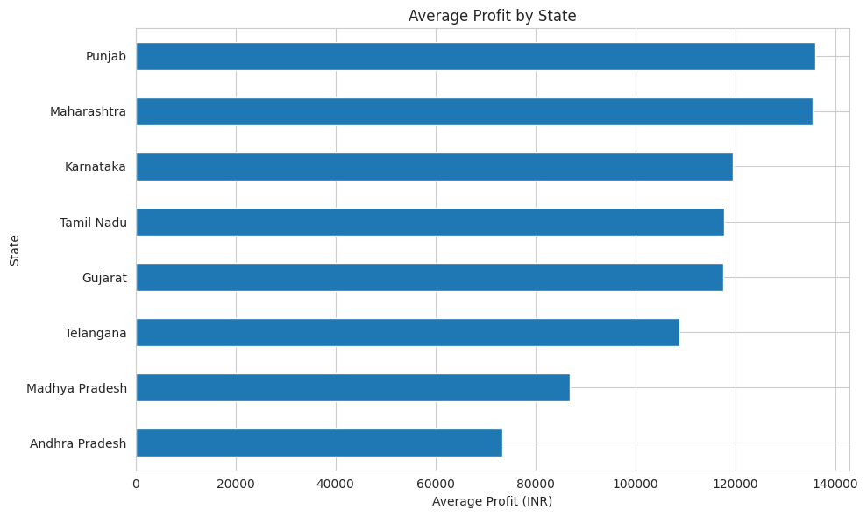
RESULTS: Average Profit By State
CODE:-
profit_state = df.groupby("State")["Profit_INR"].mean().sort_values()
plt.figure(figsize=(10,6))
profit_state.plot(kind="barh")
plt.title("Average Profit by State")
plt.xlabel("Average Profit (INR)")
plt.ylabel("State")
plt.tight_layout()
plt.show()
Observation:-
Punjab and Maharashtra have the highest average profit in the dataset. Andhra Pradesh has the lowest average profit among the states shown.

Slide 10
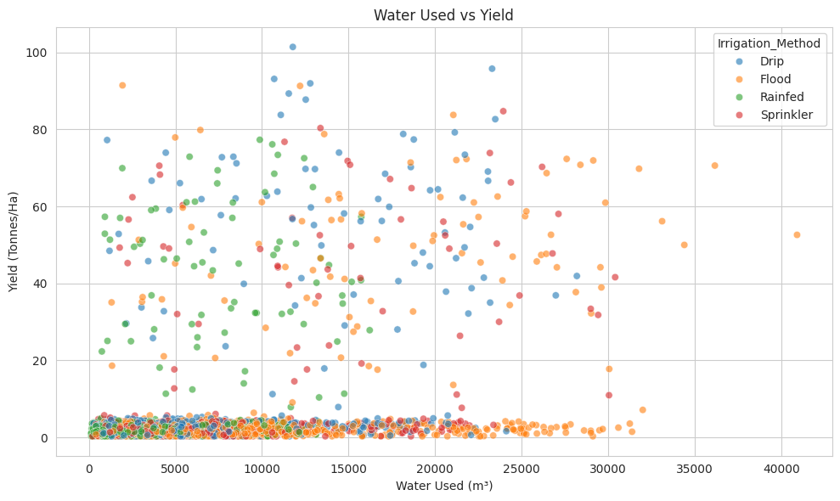
RESULTS: Water Use Vs Yield
CODE:-
plt.figure(figsize=(10,6))
sns.scatterplot(
data=df,
x="Water_Used_m3",
y="Yield_Tonnes_Ha",
hue="Irrigation_Method",
alpha=0.6
)
plt.title("Water Used vs Yield")
plt.xlabel("Water Used (m³)")
plt.ylabel("Yield (Tonnes/Ha)")
plt.tight_layout()
plt.show()
Observation:-
The points are spread across different water-use and yield levels. The irrigation groups also show different patterns.
Water efficiency is more strongly related to yield than total water used alone in this dataset

Slide 11
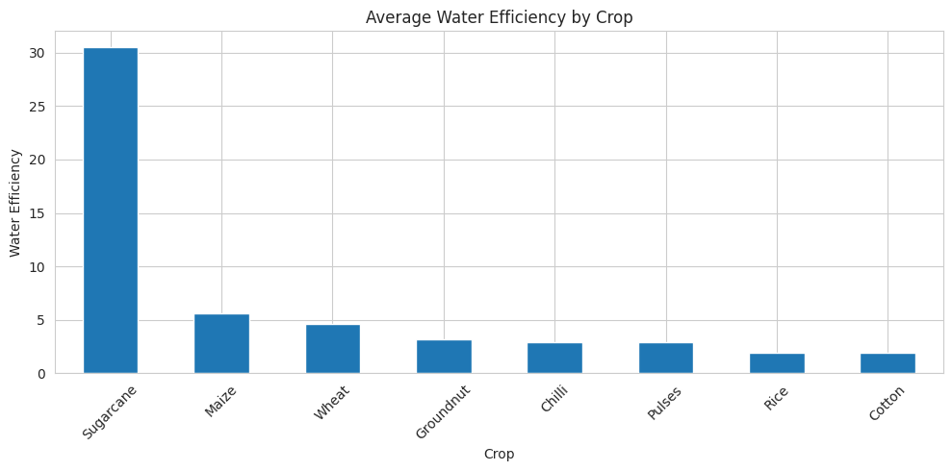
RESULTS: Average water Efficiency By Crop
CODE:-
water_efficiency = df.groupby("Crop")["Water_Efficiency_t_per_1000m3"].mean().sort_values(ascending=False)
plt.figure(figsize=(10,5))
water_efficiency.plot(kind="bar")
plt.title("Average Water Efficiency by Crop")
plt.xlabel("Crop")
plt.ylabel("Water Efficiency")
plt.xticks(rotation=45)
plt.tight_layout()
plt.show()
Observation:-
Sugarcane has a much higher average water-efficiency value than the other crops. Maize also has relatively high water efficiency.
Sugarcane is quite different from the other crops, so this value should be considered as an outlier when comparing crops.

Slide 12
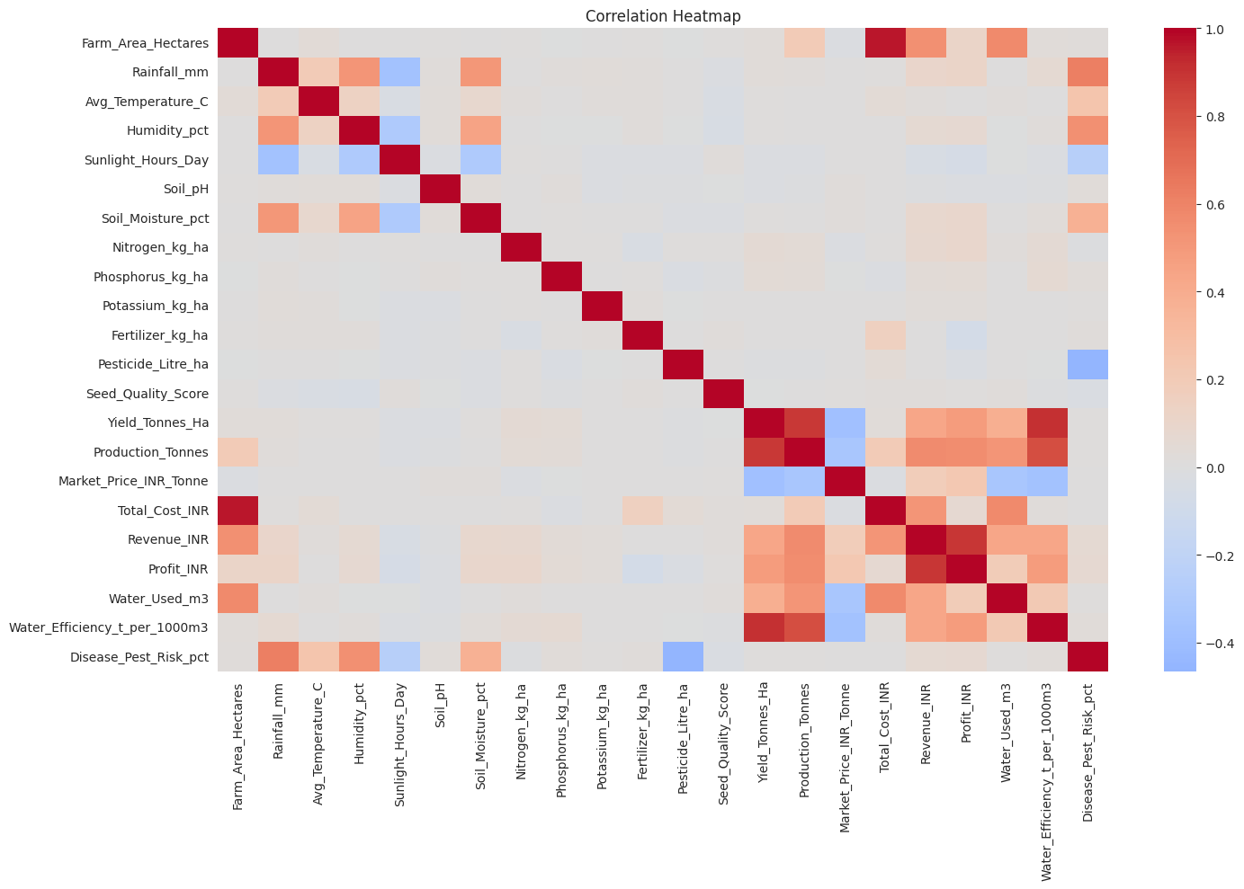
RESULTS: Correlation HeatMap
CODE:-
numeric_data = df.select_dtypes(include=np.number)
plt.figure(figsize=(15,10))
sns.heatmap(numeric_data.corr(), cmap="coolwarm", center=0)
plt.title("Correlation Heatmap")
plt.tight_layout()
plt.show()
Observation:-
Revenue has a strong positive relationship with Profit.
Production and Yield have a strong relationship.
Water Efficiency has a very strong positive relationship with Yield.
Some other variables have weaker relationships.

Slide 13
Future scope
Predicting crop yield using Machine Learning
Predicting farm profit based on available data
Suggesting suitable crops for different conditions
Suggesting better irrigation methods
Adding real-time weather data
Creating an interactive dashboard using Power BI or Tableau

Slide 14
GitHub Link
https://github.com/ry1567196-hub/seasonal-agriculture-performance-analysis.git

Slide 15

VOIS Course completion certificate- Course name- Data Visualization

Slide 16
Thank you
.
.

